Slide 1
Objects and Classes
BACS2023
Object-Oriented Programming
Chapter 4 – Part 1
1
1

Slide 2
Learning Outcomes (1)
At the end of this lesson, you should be able to
Describe objects and classes.
Use UML graphical notations to model classes and objects.
Declare a class and create an object from a class.
2
Notes:
2

Slide 3
Procedural Paradigm VS. Object-oriented Paradigm
Procedural Paradigm (PP) | Object-Oriented Paradigm (OOP)
Data & methods are loosely coupled. | Couples data and methods together into objects.
Software design focuses on designing methods. | Software design focuses on objects and operations on objects.
As data and operations on the data are separate, this methodology requires sending data to methods. | Places data and the operations pertaining to the data within a single entity called an object.

Slide 4
OO Programming Concepts (1)
Object-oriented programming (OOP) involves programming using objects.
An object represents an entity in the real world that can be distinctly identified, e.g. a student, a desk, a circle, a button, a loan.
An object is an instance of a class.
An object has a unique identity, state and behaviors.
The state of an object consists of a set of data fields (also known as properties) with their current values.
The behavior of an object is defined by a set of methods.
4

Slide 5



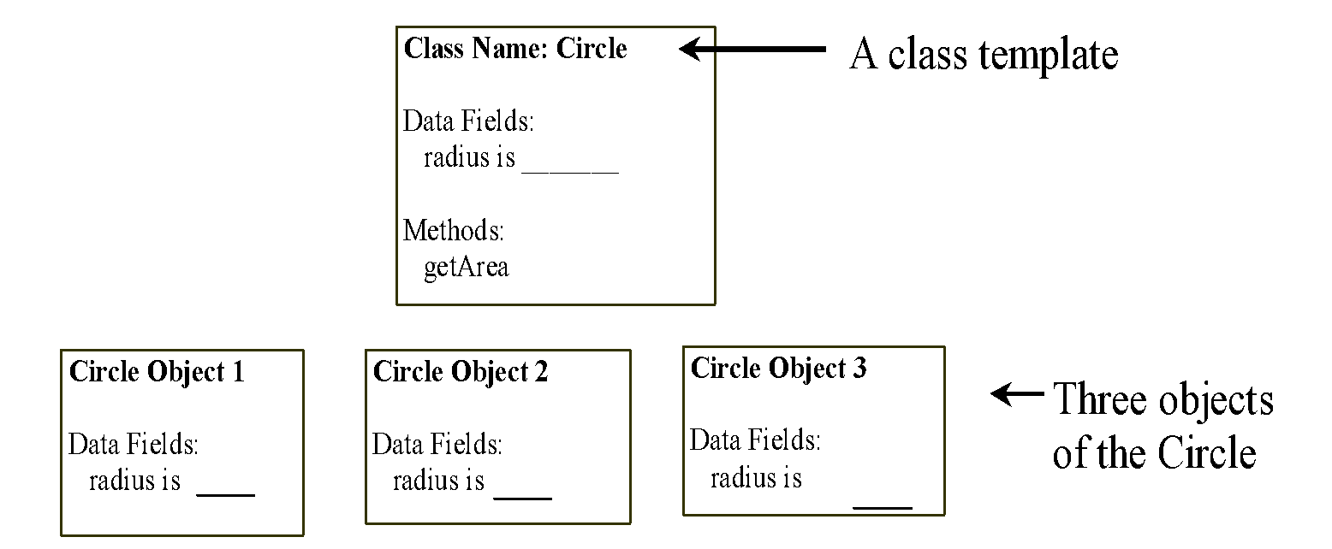
Objects
Object
An object has both a state and behavior.
The state defines the object.
The behavior defines what the object does.
5

Slide 6
Example
public class Circle {
double radius;
double getArea() {
return Math.PI * radius * radius;
}
}
public class TestCircle {
public static void main(String[] args) {
Circle c = new Circle();
c.radius = 10;
System.out.println(“Radius “ + c.radius );
System.out.println(“Radius “ + c.getArea());
}
}
Object
Circle template
Notes:
Just mention that to create an object, the new operator is used. More on constructors will be covered later.

Slide 7
Classes (1)
Classes are constructs that define objects of the same type.
A class uses
variables to define data fields and
methods to define behaviors.
Additionally, a class provides a special type of methods, known as constructors, which are invoked to construct objects from the class.
7

Slide 8
Classes (2)
class Circle {
double radius;
Circle() {
}
double getArea() {
return Math.PI * radius * radius;
}
}
Data field (State)
Constructor
Method (behavior)
8

Slide 9
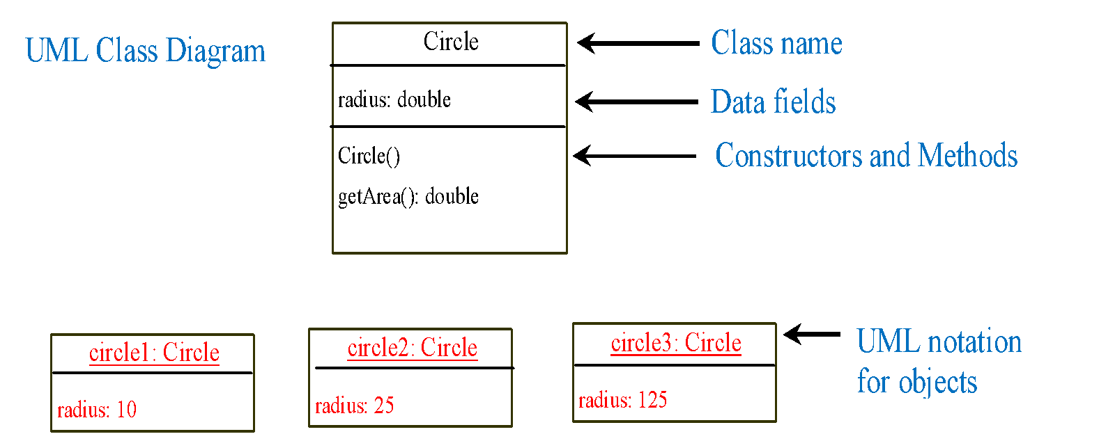
UML Class Diagram
Notes:
Unified Modeling Language (UML)

Slide 10
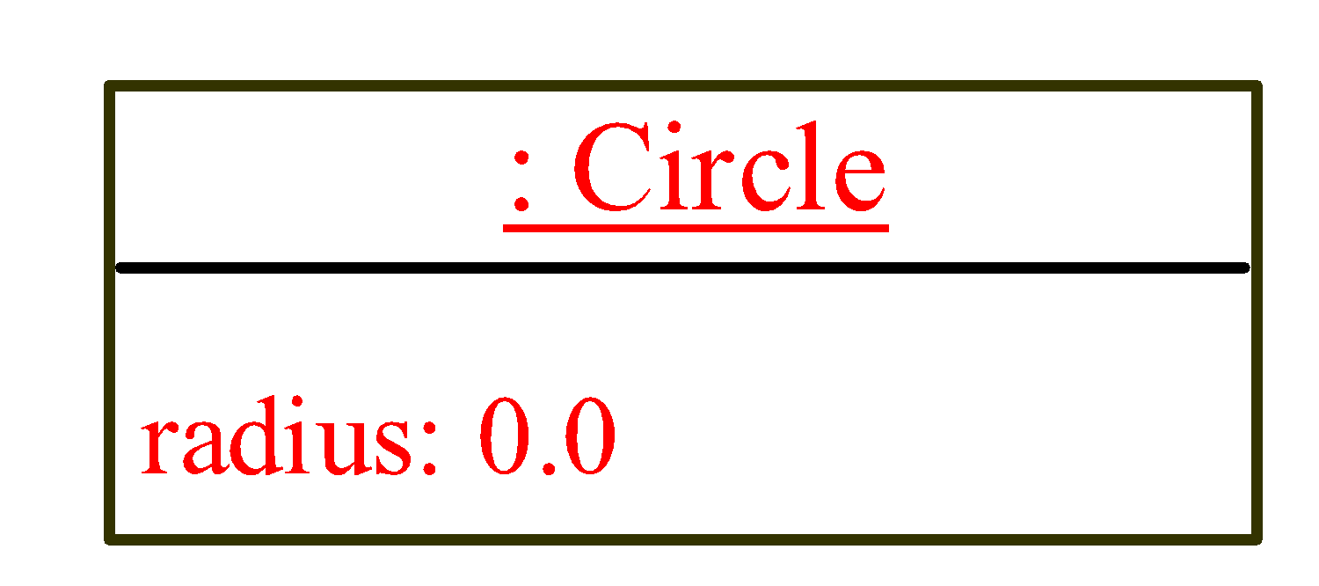
Declaring Object Reference Variables
To reference an object, assign the object to a reference variable.
To declare a reference variable, use the syntax:
Method 1:
ClassName objectRefVar;
e.g: Circle myCircle;
myCircle = new Circle();
Method 2:
ClassName objectRefVar = new ClassName();
e.g: Circle myCircle = new Circle();
myCircle
reference value

Slide 11
Accessing Objects
Referencing the object’s data:
objectRefVar.data
e.g.,
Circle myCircle = new Circle();
myCircle.radius = 5.0;
System.out.println(myCircle.radius);
Invoking the object’s method:
objectRefVar.methodName(arguments)
e.g.,
System.out.println(myCircle.getArea());
11

Slide 12
A Simple Circle Class
class Circle {
double radius;
Circle() {
}
double findArea() {
return Math.PI * radius * radius;
}
}
public class TestCircle {
public static void main(String[] args) {
Circle c1 = new Circle();
Circle c2 = new Circle();
c2.radius = 5.0;
System.out.println(“Radius = " + c1.getRadius()); //0.0
System.out.println(“Radius = " + c2.getRadius()); //5.0
System.out.println(“Area = " + c1.findArea() ); //0.0
System.out.println(“Area = " + c2.findArea() ); //78.5
}
}

Slide 13
Trace Code (1)
animation
Circle c1 = new Circle();
Circle c2 = new Circle();
c2.radius = 5.0;
Declare c1
c1
null
Note:
c1 is an object reference. It will be used to store the address of a Circle object.

Slide 14
Trace Code (2)
animation
Circle c1 = new Circle();
Circle c2 = new Circle();
c2.radius = 5;
c1
null
Create a Circle object

Slide 15
Trace Code (3)
animation
Circle c1 = new Circle();
Circle c2 = new Circle();
c2.radius = 5.0;
c1
Assign object reference to c1
Note:
The address of the newly created object is assigned to the object reference c1, i.e. c1 will now be “pointing to” the Circle object.

Slide 16
Trace Code (4)
animation
c1
Circle c1 = new Circle();
Circle c2 = new Circle();
c2.radius = 5.0;
c2
null
Declare c2

Slide 17
Trace Code (5)
animation
Circle c1 = new Circle();
Circle c2 = new Circle();
c2.radius = 5.0;
c1
c2
null
Create a new Circle object

Slide 18
Trace Code (6)
animation
Circle c1 = new Circle();
Circle c2 = new Circle();
c2.radius = 5.0;
c1
c2
Assign object reference to c2

Slide 19
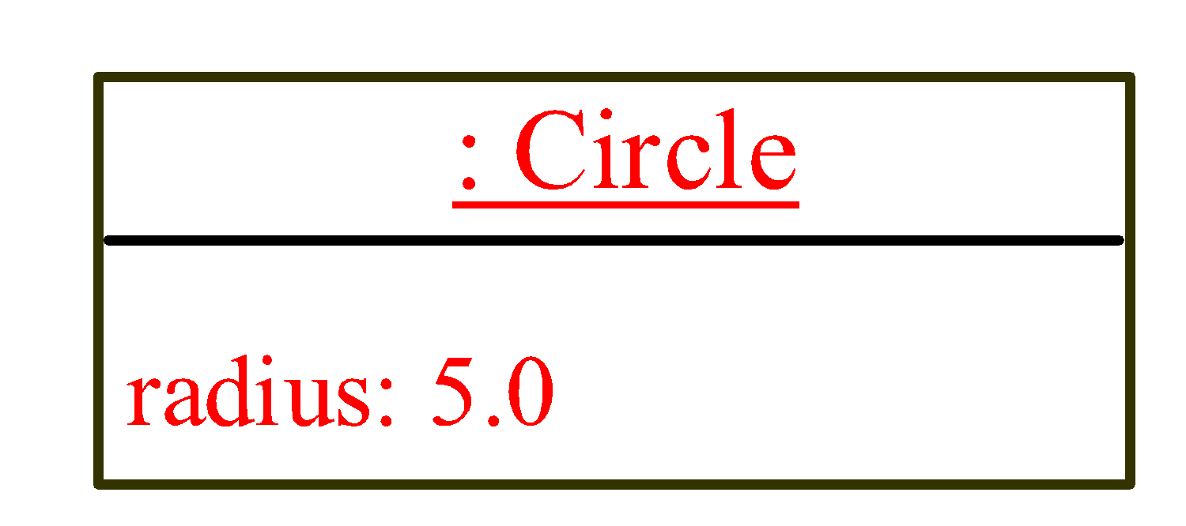
Trace Code (7)
animation
Circle c1 = new Circle();
Circle c2 = new Circle();
c2.radius = 5.0;
c1
c2
Change radius in c2

Slide 20
Review of learning outcomes
You should now be able to
Describe objects and classes.
Use UML graphical notations to model classes and objects.
Declare a class and create an object from a class.
Notes:
20

Slide 21
Objects and Classes
BACS2023
Object-Oriented Programming
Chapter 4 – Part 2

Slide 22
Learning Outcomes (2)
At the end of this lesson, you should be able to
Differentiate between classes and objects.
Explain how to access objects via object reference variables.
Write constructors in classes.
Notes:
22

Slide 23
Classes
A class is a template that defines the form of an object.
A class consists of 2 parts:
Data Members
Data or properties of a class.
The nouns of the class.
Represents the state of its objects.
Method Members
Functions or actions of a class,
The verbs of the class.
The code that will operate on the data of the class.
Implementation of its objects’ behaviors.
Class Name: BankCustomer
Data member(s)
Name
I/C Number
Address
Balance
Method member(s)
Create new Customer
Deposit money
Withdraw money
Transfer money

Slide 24
Objects vs Classes (1)
An object is an instance of exactly one class.
A class is a logical abstraction. Defines what data to store and what actions we can operate on the data.
Only when we create an object, then we have a actual physical representation of that class exists in memory.
Class Name: BankCustomer
Data member(s)
Name
I/C Number
Address
Balance
Method member(s)
Create new Customer
Deposit money
Withdraw money
Transfer money
One object can only belong to one class, while one class can have multiple objects.
Tan Chee
193, Jln Big, KL
451021-9-6390
RM4066.67
Ali Mohd
23, Jln A1, Ipoh
510215-6-5533
RM456.98
Notes:
When we create an object from a class

Slide 25


Objects vs Classes (3)
Are all the marvel charaters above same?

Slide 26
Defining a Class
The general form of a class definition is shown here:
public class <class name> {
}
//declare instance variables
type var1;
type var2
. . .
type varN
Data part
//declare methods
Method 1
Method 2
…….
Method n
Method part

Slide 27




Develop a class that represents cars, vans and trucks.
What is the class name?
What are the common properties?
Notes:
Class Name :
Vehicle
Properties:
plate number
number of passengers
fuel capacity
etc

Slide 28
Data Members of the Vehicle Class
// Vehicle class definition
class Vehicle {
String plateNo;
int passengers;
int fuelCap;
}
A class definition creates a new data type.
In this case, the new data type is called Vehicle.
We will use this name to declare objects of type Vehicle.

Slide 29
Creating a Vehicle Object (1)
A class declaration is only a type description, it DOES NOT create an actual object.
To actually create a Vehicle object, use the following statement.
Vehicle car = new Vehicle();
Class name
object reference variable
car will be an instance of Vehicle (thus, it will have “physical” reality).

Slide 30
Creating a Vehicle Object (2)
Vehicle car1 = new Vehicle();
The new operator dynamically allocates (that is, allocates at run time) memory for an object and returns a reference to it.
car1
plateNumber
passenger
fuelCap
Each time the instance of a class is created, the object contains its own copy of each instance variable defined by the class.

Slide 31
Default Value for a Data Field
The default value of a data field is
null for a reference type
0 for a numeric type
false for a boolean type
'\u0000' for a char type.
car1
plateNumber
null
passenger
0
fuelCap
0
31

Slide 32
Accessing Data Members in the Vehicle Object
car
plateNo
W1
public class VehicleDemo{
public static void main(Sting args [ ]) {
Vehicle car = new Vehicle();
car.plateNo = “W1”;
car.Passengers = 4;
car.fuelCap = 20;
System.out.print(“Plate No: ” + car.plateNo );
System.out.print(“Number of passengers: ” + c ar.passengers);
System.out.print(“Fuel capacity: ” + car.fuelCap + “ gallons” );
}
}
passengers
4
fuelCap
20

Slide 33
Note
If there is more than one class in a file, only one class can be a public class.
The public class must have the same name as the file name.
The main method must be in a public class.
class Vehicle{
……
}
public class VehicleDemo{
public static void main(Sting args [ ]) {
…..
}
}

Slide 34
Class Methods (1)
Methods are subroutines
What the class can do or perform.
They provide access to and manipulate the data members of the class.
We will add a method called range() to the Vehicle class to return fuel capacity * miles per gallon.

Slide 35
Class Method Invocation
class Vehicle {
String plateNo;
int passengers;
int fuelCap;
int mpg;
int range() {
return fuelCap * mpg;
}
}
public class VehicleDemo2 {
public static void main(Sting args [ ]) {
Vehicle car = new Vehicle();
car.plateNo = “W1”;
car.Passengers = 4;
car.fuelCap = 20;
car.mpg = 10;
//...
System.out.println(“Range: ” + car.range() + “ miles”);
}
}
call range() method

Slide 36

Constructors (1)
Constructors are a special kind of method that are invoked to construct objects.
A constructor with no parameters is referred to as a no-arg constructor (aka default constructor).
Constructors must have the same name as the class itself.
Constructors do not have a return type - not even void.
Invoked when using the new operator.
Constructors play the role of initializing objects

Slide 37

Creating Objects Using Constructors
class Circle {
double radius;
Circle() {
}
Circle(double r){
radius = r;
}
double getArea() {
return Math.PI * radius * radius;
}
}
How many constructors can be found within the class?
Notes:
Answer : Two

Slide 38
Creating Objects Using Constructors
class Circle {
double radius;
Circle() {
}
Circle(double r){
radius = r;
}
double getArea() {
return Math.PI * radius * radius;
}
}
Example:
new Circle();
new Circle(5.0);

Slide 39
Default Constructor
A class may be declared without constructors. In this case, a no-arg constructor with an empty body is implicitly declared in the class.
Eg: Circle( ){ }
This constructor, called a default constructor, is provided automatically only if no constructors are explicitly declared in the class.
class Circle {
double radius;
}
class Circle {
double radius;
Circle() {
}
}

Slide 40
The new Operator
What actually took place when the new operator was used in the main method of VehicleDemo.java?
A Vehicle object was created by the default constructor for Vehicle and its fields were initialized to their default values.
this approach would never be used in professionally written Java code!
Vehicle car = new Vehicle();
car.plateNo = “W1”;
car.Passengers = 4;
car.fuelCap = 20;
car.mpg = 10;
…….
}
There is a better way to initialize values to object Constructor

Slide 41
Adding a Parameterized Constructor to Vehicle Class
class Vehicle{
String plateNo;
int passengers;
int fuelCap;
int mpg;
Vehicle (String no, int p, int f, int m){
plateNo = no;
passengers = p;
fuelCap = f;
mpg = m;
}
int range(){
return fuelCap * mpg;
}
}
Constructor:
Same name as class name
No return type
Receive parameter to set values to data members

Slide 42


Calling the Parameterized Constructor
car.plateNo = “W1”;
car.Passengers = 4;
car.fuelCap = 20;
car.mpg = 10
Vehicle car = new Vehicle(“W1”, 4, 20, 10);

Slide 43

Class Constructors (1)
Recall that a constructor
is a special method.
initializes an object when it is created.
has the same name as the class name.
has no explicit return type.
We use constructors to
give initial values to the instances variables defined by the class.
perform any other startup procedures required to create a fully formed object.

Slide 44
Class Constructors (2)
Constructors may be
Constructors with parameters (parameterized constructors)
No-argument / no-arg constructors
Default Constructors
class Vehicle{
Vehicle(){
plateNo = “”;
}
Vehicle (String No, int p, int f, int m){
plateNo = No;
passengers = p;
fuelCap = f;
mpg = m;
}
}
No-argument
parameterized constructors

Slide 45

Exercise Re-design the following program by using Object-Oriented way
public class myLoan{
public static void main(String [] args){
int terms = 3;
double amount = 1000.00;
double monthlyInstalment = amount/terms;
System.out.print(“Monthly Instalment : “ +
monthlyInstalment);
}
}
Create a class named Loan

Slide 46
Review of learning outcomes
You should now be able to
Differentiate between classes and objects.
Explain how to access objects via object reference variables.
Write constructors in classes.
46
Notes:
46

Slide 47
To Do
Review the slides and source code for this chapter.
Read up the relevant portions of the recommended text.
Do the tutorial and complete the remaining practical questions for this chapter.
We shall selectively discuss them during class.
47
47

